Slide 1
Better Together Evaluation
05/07/2023

Slide 2
Opportunity for Evaluation: Answer Important Questions
Important Questions (Good)
Evaluation Desiderata
What should I read? Cite?
What’s Hot & What’s Not?
Which papers are
tearing up the charts?
Which authors are
rising stars
Timeliness (Update Story)
Post model on HuggingFace
COVID happens
How long are models good for?
Sell-by dates for SciBERT
Evaluation data must be causal
Evaluation should check forecasting capability
Evaluation tasks should reflect a real-world use, not some arbitrary Benchmark task
Evaluation data must be updatable (in two years, literature will have changed)

Slide 3
Pitfalls with Evaluating Paper Systems
Evaluating within the Train set time: artificially easy (when we write papers, we can’t see what will be published in the future), introduces leakage
Tasks artificially simplified: Citation recommendation tasks propose negatives as those papers with a restricted training set (1K-100K). In reality, the number of negatives is closer to 100M.
Small data sets: Some tasks may have as few as 30 samples, which is not enough to differentiate between systems with different capabilities
Notes:
Notes from Ken:
Record myself on zoom call and measure how much time to spend on each slide. >2 slides
Provide some memes and keep things snappy

Slide 4
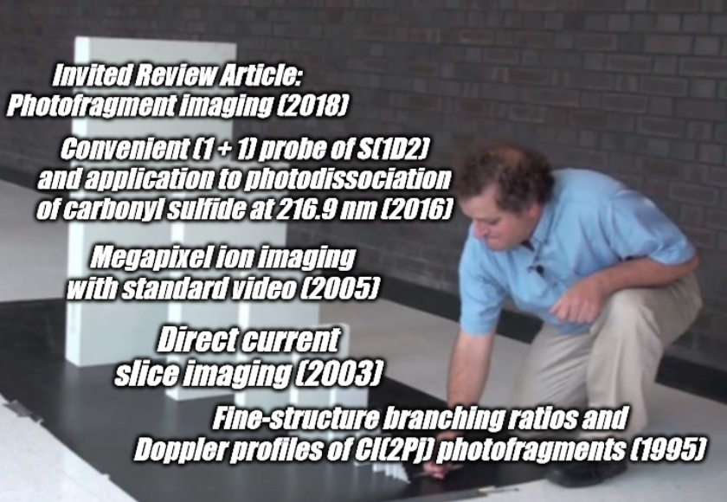
Evaluation data must be causal
Typical ML approach is randomly partition test and train data
However, with temporal data we must have a sense of cause and effect: any referenced paper should be considered ‘seen’
Partition and evaluate accordingly

Slide 5
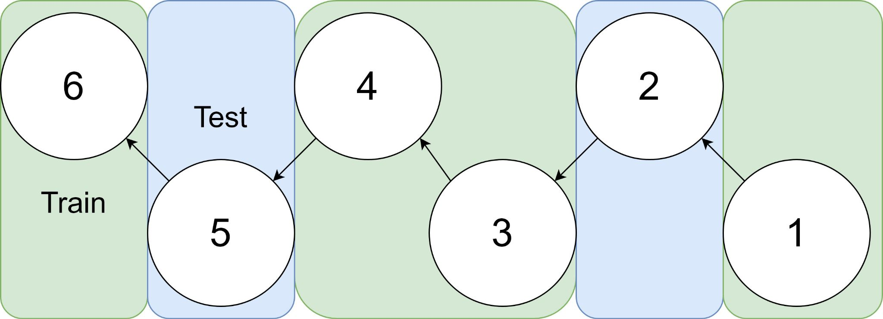
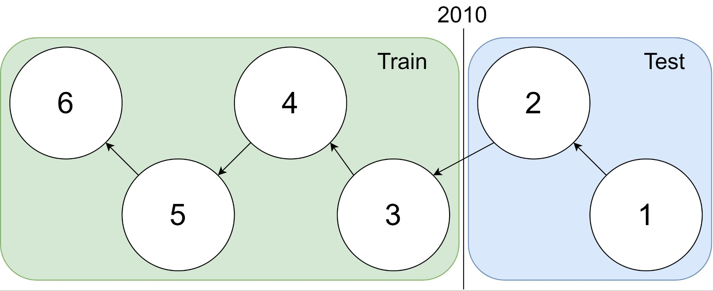
Graph Sample
Traditional Train-Test Split
idx | Pub Year | Paper Title
1 | 2018 | [...] Photofragment imaging
2 | 2016 | Convenient probe of S(1D2)[...]
3 | 2005 | Megapixel ion imaging [...]
4 | 2003 | Direct current slice imaging [...]
5 | 1995 | profiles of Cl(2Pj) photofragments [...]
6 | 1988 | Adiabatic dissociation of [...]
Causality Respecting Train-Test Split
Notes:
No asymmetry of time - how to reduce to a soundbite
Audience soundbites
‘Almost all studies in ml do test-train split’ that’s a bad idea when you have time

Slide 6
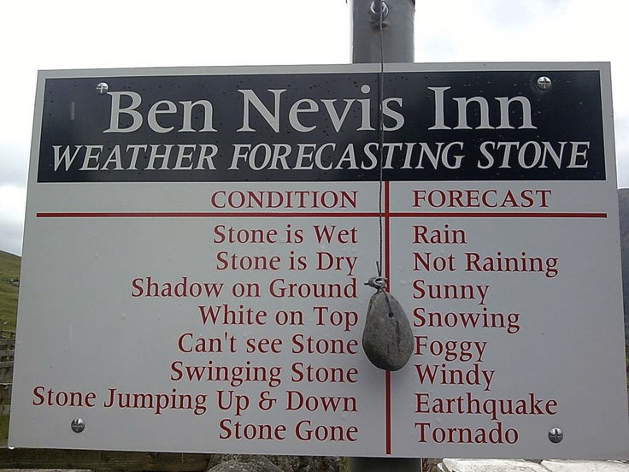
Evaluation should check forecasting capability
Make correct predictions repeatedly across a reasonable amount of time
Not interesting to ‘forecast’ into the past or the present
Deployed models typically have frozen parameters. Therefore they are always forecasting

Slide 7
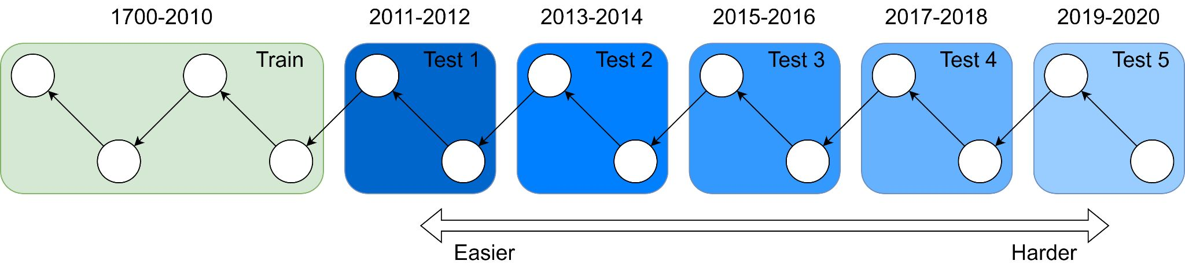
Forecasting
Intuition: as we try these tasks further out, things get muddier. If you’re an expert in 2010 what do you know about COVID, AlphaGo, South Sudan, etc?
Question: How to quantify this?
LLM: Perplexity of SciBERT across different bins, BPE compressibility
Better Together Eval: task performance at y+1, y+2, y+n (up to 2023*)

Slide 8
Evaluation tasks should reflect a real-world use
Citation Recommendation - the paradigmatic Better Together task - What does Paper A reference?
Simple implementation: get Paper A vector representation with model M and retrieve the nearest papers
Can also make Citation Recommendation local: given a sentence in Paper A predict that reference.
Many valencies around features, number of negatives, scoring (classification vs retrieval)
Example: How do Dogs Walk?
Erroneous Quadruped Walking Depictions, Horváth et al (2009)
“Although humans have observed walking quadrupeds for thousands of years, the exact characterization of the walking of tetrapods had to wait for the advent of photography [?]”
Task: Find a reference to a (History of Science) paper describing the process of photographing tetrapod walking
Notes:
Thesis: it will be harder to do Citation Recommendation as Paper A is chosen further forward in time due to citation graph evolution and academic topic development

Slide 9
Evaluation tasks should reflect a real-world use
Citations after k Years - How many citations did Paper A have after k years?
‘Hit Prediction’, that is, will a paper be successful.
More specifically we ask ‘will the model be ‘a hit’ at a specific time, which is relevant to academic literature as certain topics wax and wane in terms of field attention.
Repeat References - Given A references B, how many times does it reference B?
Agnostic about what multiple references means, but it probably means something
Publication Year - What year is paper A published?
Is a paper timely? Is the model capable of inferring time from the (messy) citation graph
Venue Prediction - Which venue is paper A published in?
Helpful to users: I’ve written a paper in a new area for me, where do I send it?
Peer Reviewer Score - What score was this paper given on OpenReview?
Very hard, potentially aleatory uncertainty in the reviewing process (what did reviewer 2 have for breakfast?) but powerful

Slide 10
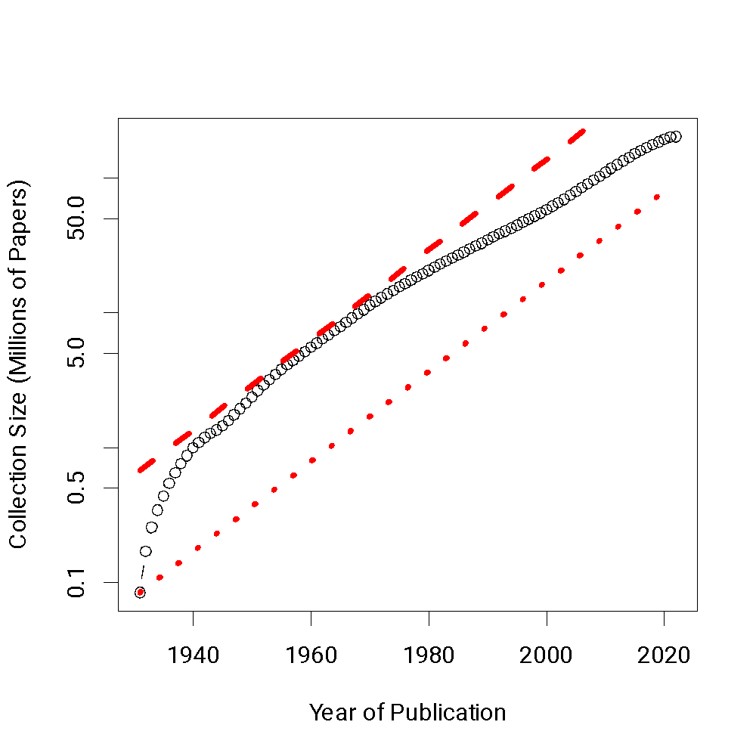
Evaluation data must be updatable
Tasks are derived from core Semantic Scholar data or from APIs which we can join with Semantic Scholar IDs
We define our evaluation set as a function we can run on Semantic Scholar to update at reasonable intervals to reflect shifts over time
These updates will keep model producers honest: is your model from 2016 still good in 2023?

Slide 11
Better Together Evaluation
Evaluation Desiderata
Evaluation data must be causal
Graph is partitioned by date such that models cannot peek forwards in time (where possible)
Evaluation should check capability
With the same tools we use to partition train-test, we make bins which record how far out each prediction is
Evaluation data must be updatable (in two years, literature will have changed)
We create our evaluation as a pipeline against large-scale maintained data-sources to make updates as straightforward as possible
Evaluation tasks should reflect a real-world use, not some arbitrary Benchmark task
We pick a set of evaluation tasks which would be of use to Academic Document authors

